Slide 1
IE.2407/2307 : Internet of Thing and electronic system
Xun ZHANG
Officeroom: L209
Email: xun.zhang@isep.fr

Slide 2
Syllabus: IoT electronic system
📜 Course Description:
The study of IoT system and technological and societal aspects of the INTERNET OF THINGS
🗝 Enrollment
Prerequisite(s): course(s) that must be taken prior to this course Co-Requisite(s): assignment should be well done and return me back in time Concurrent Enrollment: particiaption

Slide 3
Course Schedule
13 class : 25th Sept. - 15th Jan. 2024, Monday from 9:00 to 12:00
5 lectures 25/02/09/16/23
AI based Sensing data calibration projet (6 class and projet examen)
-> final writing examen : 15th Jan.

Slide 4
Evaluation
Assignment Submission
All essays and papers are due in lecture (due dates are listed on the schedule). No electronic copies will be accepted!
Late Assignments
Late work will be deducted 5% per twenty-four-hour period that elapses after the due date. If foreseen or unforeseen circumstances prevent you from completing an assignment on time, you may request an extension. Extensions must be requested in advance of the due date. If the situation warrants an extension, we will determine a new due date for the essay based on your individual circumstances.
😢 Plagiarism
Presenting someone else’s ideas as your own, either verbatim or recast in your own words – is a serious academic offense with serious consequences. Please familiarize yourself with the discussion of plagiarism in our campus policies.
🧠 Final Examination
The final examination will consist of an essay written during the exam period. You will receive the question at least one week before the test and may use a single page of notes during it.
🏆 Grading
Participation: 15%
Assignment : 15%
Project: 40%
Final Exam: 30%

Slide 5
Course Objectives
-> Technological and Societal aspects of the Internet of Things
-> IoT prototyping
-> IoT sensors and Actuators
-> IoT security
-> IoT Data communication buses
-> IoT wireless networks
-> IoT power management

Slide 6
Program Learning Outcomes
01
Demonstrate sound knowledge of the literature and a comprehensive understanding of scientific methods and techniques relevant to IoT
02
Demonstrate practical skills in building IoT systems
PLO
04
Independently pursue research and innovation of significance in IoT applications
03
Critically apply theories, methodologies, and knowledge to address fundamental questions in IoT
05
Demonstrate skills in oral and written communication sufficient for a professional career

Slide 7
What’s the Internet of Things
History
1997, “The Internet of Things” is the seventh in the series of ITU Internet Reports originally launched in 1997 under the title “Challenges to the Network”.
1999, Auto-ID Center founded in MIT ▪ 2003, EPC Global founded in MIT
2005, Four important technologies of the internet of things was proposed in WSIS conference.
2008, First international conference of internet of things: The IOT 2008 was held at Zurich.
2017, NB-IoT is embedded in 5G standard

Slide 8
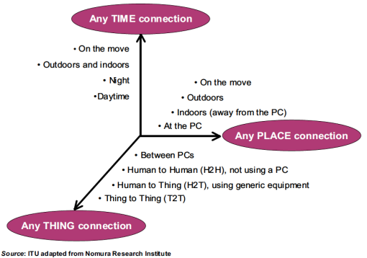
What’s the Internet of Things
From any time, any place connectivity for anyone, we will now havre connectivity for anything!

Slide 9
Content
-> Technological and Societal aspects of the Internet of Things
-> IoT prototyping
-> IoT sensors and Actuators
-> IoT security
-> IoT Data communication buses
-> IoT wireless networks
-> IoT power management

Slide 10
Definition
All kind of Objects and entities become “smart”
smart : intelligent & connected
locally,
internet
awareness (context awareness, situation awareness) Cities, Cars, streets, scales, phones, water,...
Interfaces to real world by local connection : sensors and actuators
Connection to internet: cable, RF (WiFi, NFC, sensor networks), cloud, WASN : wireless autonomous sensor networks

Slide 11
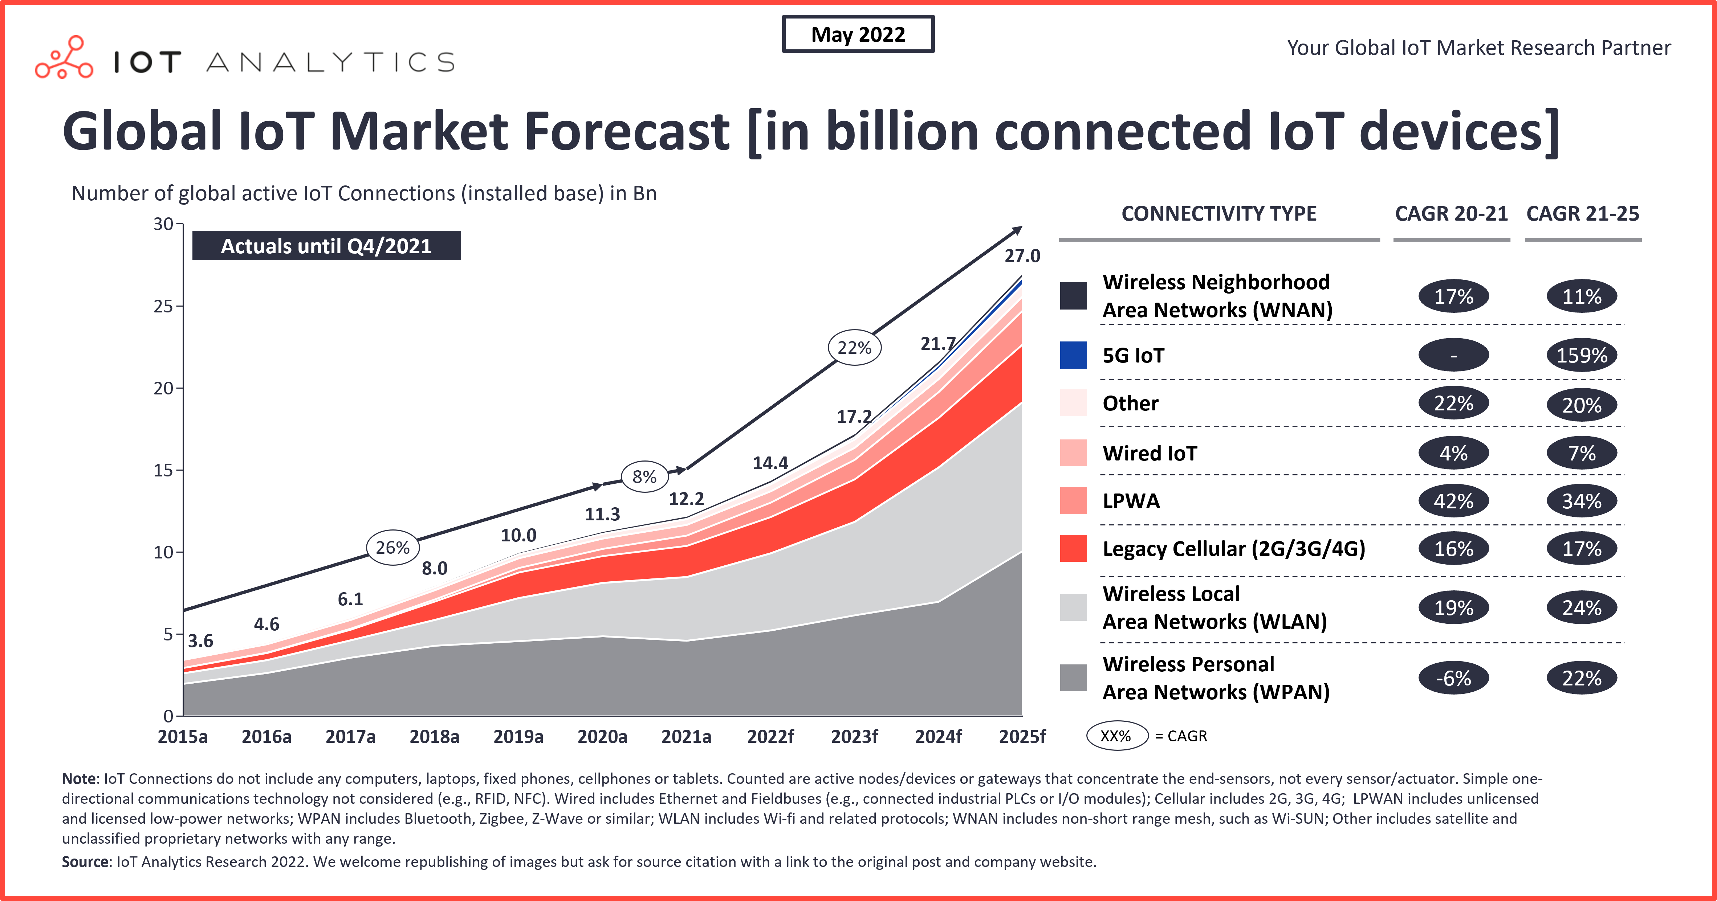
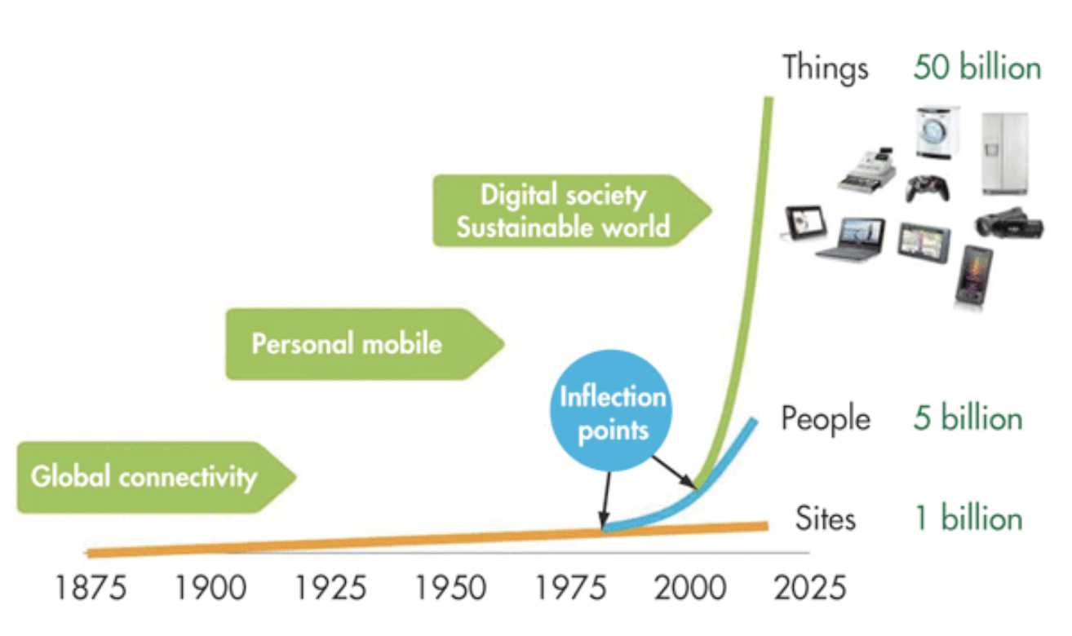
Selected IoT connection growth highlights in 2021
LPWA networks expanded, especially those using NB-IoT technology. (in areas of water and gas metering.
Users are moving away from legacy 2G/3G toward 4G/5G IoT.
The chip shortage continued to slow the market recovery
COVID-19 continued to impact products and supply chains.
Source: electronic design, 2015
Source: IoT analytics, 2022

Slide 12
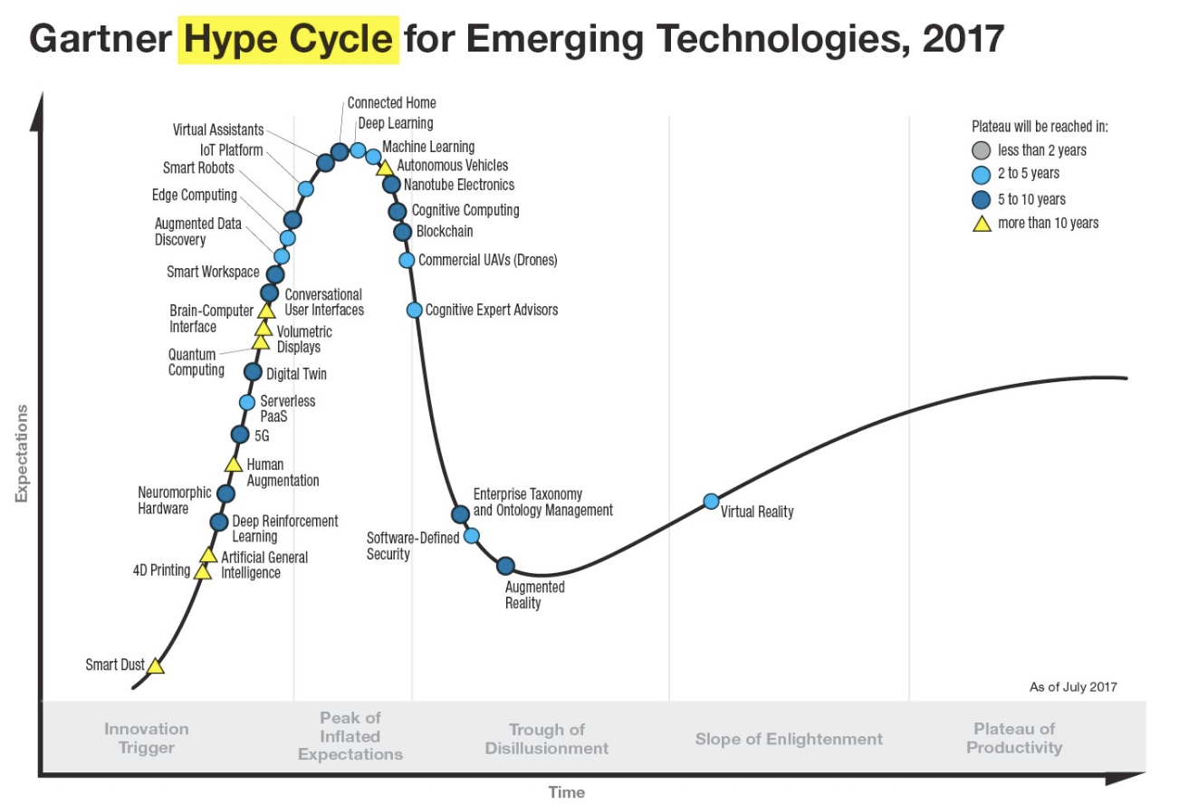
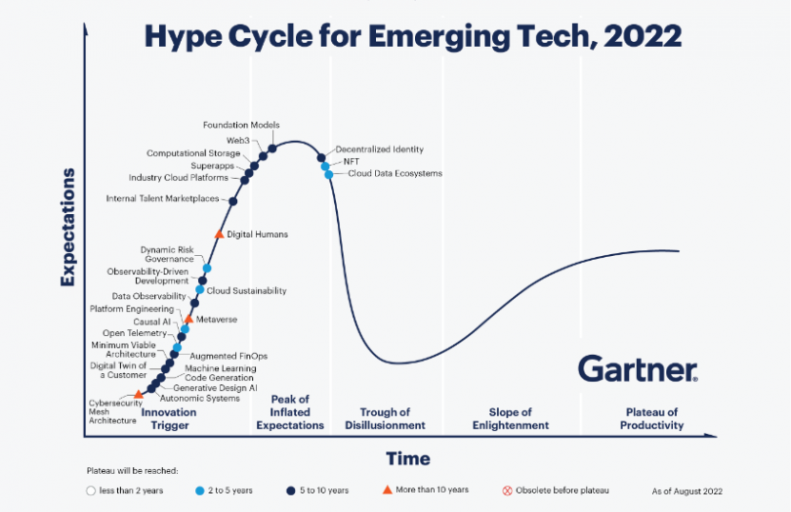
Internet of Thing today and future

Slide 13
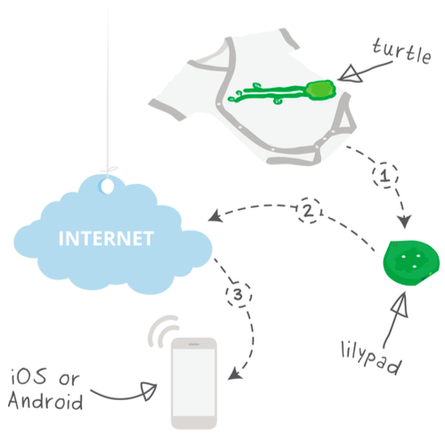
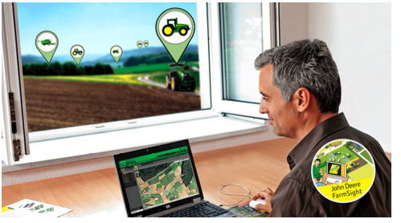
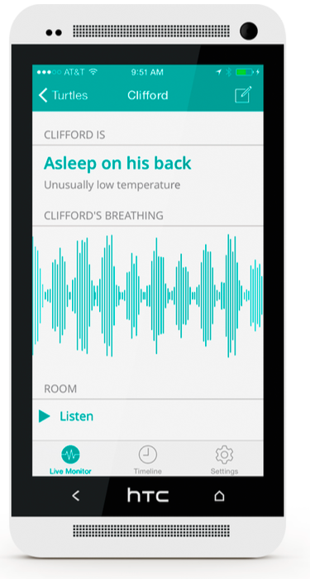
Element of Smart, Connected products
The Mimo mobile monitoring application (Photo courtesy Rest Devices, Inc.)
The Mimo IoT ecosystem (Illustration courtesy Rest Devices, Inc.)
Monitoring John Deere’s connected tractor in the field (Illustration courtesy Deere & Co.)
Solution creator
Audience
Position in the product/service lifecycle
Connection
Integration
The five key elements of smart, connected products.

Slide 14

Reference architecture for Internet of Things
Web/ Portal
Dashboard
API Management
Event Processing and Analytics
Client/external communications – Web/Portal, Dashboard, APIs
Event processing and analytics (including data storage)
Aggregation/bus layer –
ESB and message broker
Relevant transports MQTT/HTTP/XMPP/CoAP, etc.
Devices
Identity & Access Management
Aggregation / Bus Layer
ESB and Message Broker
Devices Manager
Communications MQTT/HTTP
Devices
This module is focused on “Devices layer”

Slide 15
The device Layer – the bottom layer of the architecture
Must have some communications that either indirectly or directly attaches to the Internet.
Examples of direct connections are:
Arduino with Arduino Ethernet connection
Arduino Yun with a Wi-Fi connection
Raspberry Pi connected via Ethernet or Wi-Fi
Intel Galileo connected via Ethernet or Wi-Fi Examples of indirectly connected device include:
ZigBee devices connected via a ZigBee gateway
Bluetooth or Bluetooth Low Energy devices connecting via a mobile phone
Devices communicating via low power radios to a Raspberry Pi

Slide 16
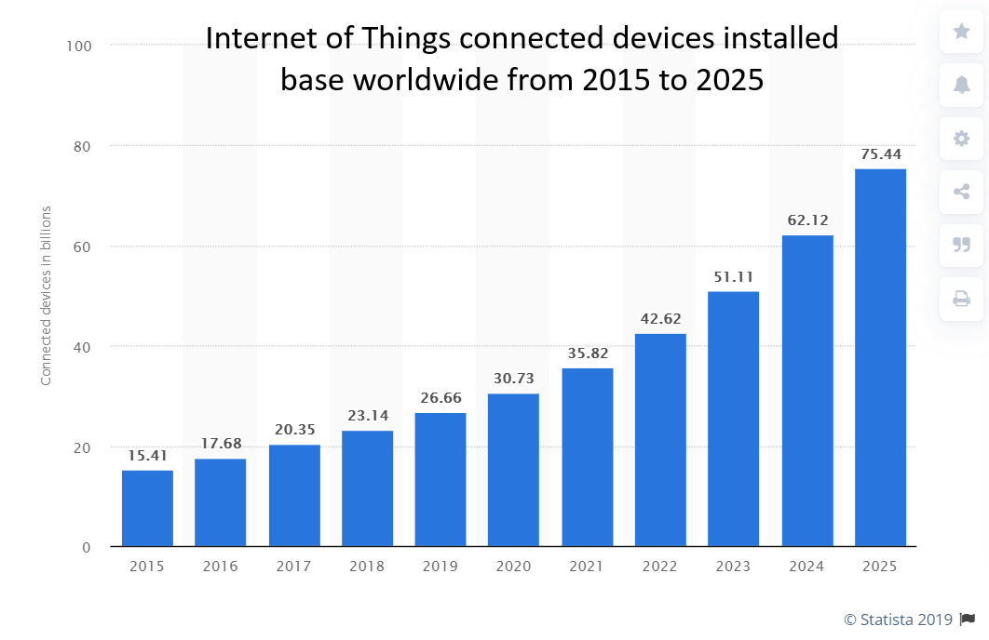
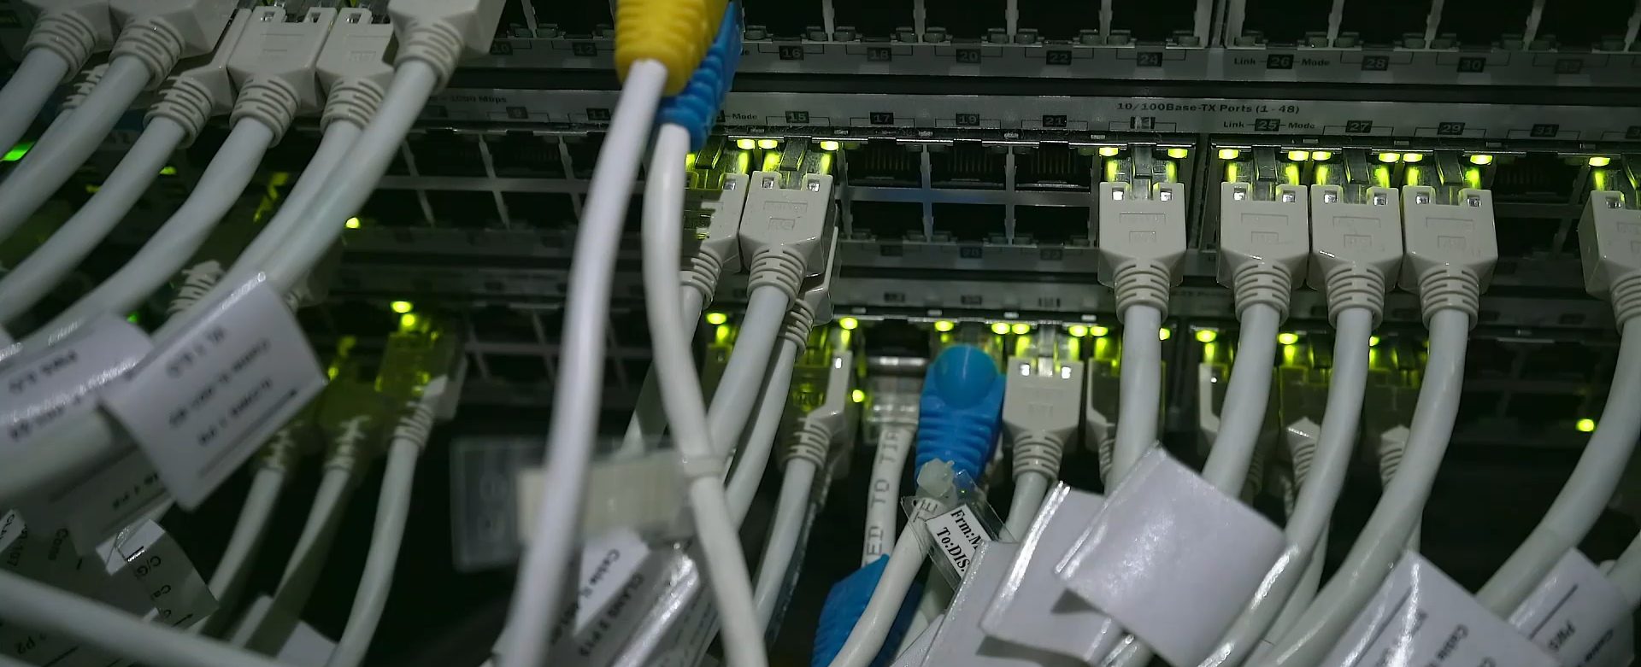
The Edge of the IoT
The edge of the IoT is where the action is. It includes a wide array of sensors, actuators, and devices—those system end-points that interact with and communicate real-time data from smart products and services.

Slide 17
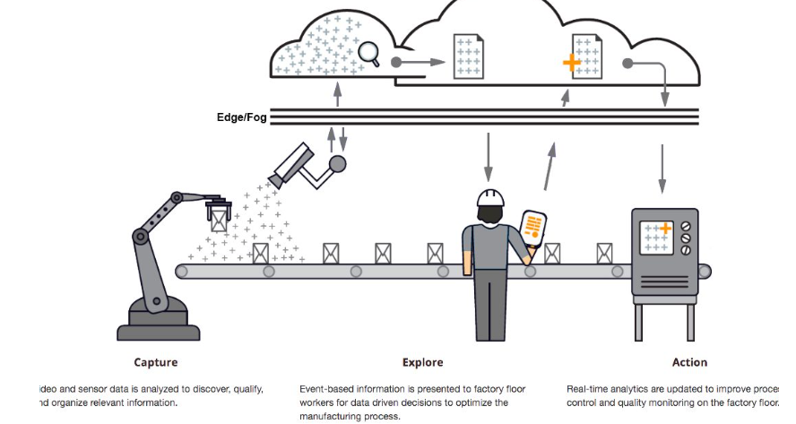



IoT, Digitize & connect
https://beacontower.io/what-is-edge-computing/
UP : quantification, digitalization & upload DOWN : download & data materialization
CLOUD : data aggregation, big data, data fusion, data correlation, data analysis, data treatment, data mining, data extraction
Combing Internet of Things & Cloud Combing social collaboration & scientific treatment

Slide 18
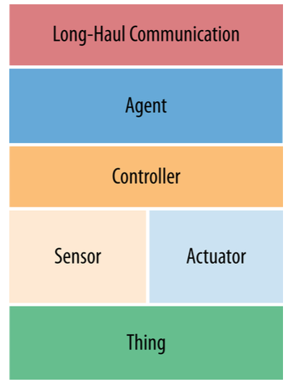
Abstract Edge Architecture Model
IoT solutions invariably require that envi‐ ronment or device status be made available to a cloud-based application for consumption by a variety of stakeholders.
The agent, an embedded program that runs on or near the IoT device and reports the status of an asset or environment.
The sensors and actuators provide the Thing’s “read and write” capabilities.
The “Thing,” that critical product or environment that is the core reason for our IoT system build.

Slide 19


Edge Architecture Examples
Controller
Embedded agent with WiFi Long-haul
Coffee machine
Sensors
Actuators
Sensors and actuators : bill validator , motors for manipulating and moving product inventory
Controller : MDB (multi-drop bus) DEX (digital exchange)

Slide 20

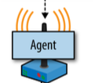
Gateway example with Cellular
Coffee machine
Cellular
Coffee machine

Slide 21
Sensors
> Having an overview of the different types and characteristics of sensors > specs and usage of sensor components in IoT
> I want to measure something – which sensor I best suited ? > I got my sensor and it does not work - how to read its specification sheet

Slide 22
Sensors - Overview
1. DEFINITION 2. CLASSIFICATION AND TERMINOLOGY 3. BASIC SENSOR SIGNAL PROCESSING SCHEME 4. SENSOR – ACTUATOR 5. BASICS OF MEASUREMENTS
> noise, repeatability, sensitivity, accuracy, drift, range, offset, saturation, reaction time (dead time)
6. FOCUS ON SOME EXAMPLES OF IOT SENSORS > Heart rate, localization
7. IOT SENSOR (quantified self, wearable sensors) 8. READING A SPEC SHEET 9. HOW TO CHOOSE AND WHERE TO BUY A SENSOR

Slide 23
Sensors - Overview
1. DEFINITION 2. CLASSIFICATION AND TERMINOLOGY 3. BASIC SENSOR SIGNAL PROCESSING SCHEME 4. SENSOR – ACTUATOR 5. BASICS OF MEASUREMENTS
> noise, repeatability, sensitivity, accuracy, drift, range, offset, saturation, reaction time (dead time)
6. FOCUS ON SOME EXAMPLES OF IOT SENSORS > Heart rate, localization
7. IOT SENSOR (quantified self, wearable sensors) 8. READING A SPEC SHEET 9. HOW TO CHOOSE AND WHERE TO BUY A SENSOR

Slide 24
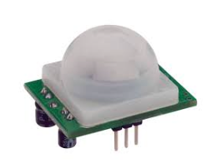

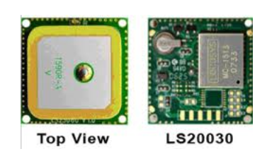
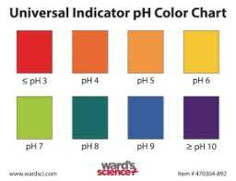
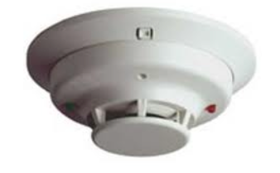
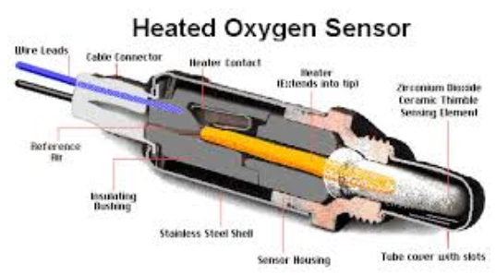
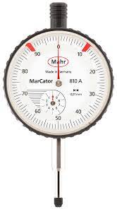

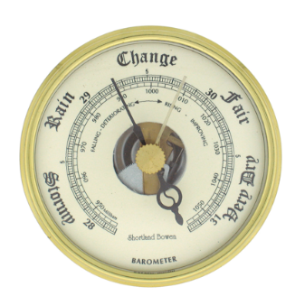
Sensor - Definition
Definition
A sensor transforms a physical quantity into a readable variable
Physical quantity (measured)
Variable (Signal)
Black
Box

Slide 25
Definition
MERRIAM-WEBSTER: a device that responds to a physical stimulus (as heat, light, sound, pressure, magnetism, or a particular motion) and transmits a resulting impulse.
WIKITUDE : A sensor is a converter that measures a physical quantity and converts it into a signal which can be read by an observer or by an (today mostly electronic) instrument.

Slide 26
Sensors - Overview
1. DEFINITION 2. CLASSIFICATION AND TERMINOLOGY 3. BASIC SENSOR SIGNAL PROCESSING SCHEME
4. SENSOR – ACTUATOR 5. BASICS OF MEASUREMENTS
> noise, repeatability, sensitivity, accuracy, drift, range, offset, saturation, reaction time (dead time)
6. FOCUS ON SOME EXAMPLES OF IOT SENSORS > Heart rate, localization
7. IOT SENSOR (quantified self, wearable sensors) 8. READING A SPEC SHEET 9. HOW TO CHOOSE AND WHERE TO BUY A SENSOR

Slide 27
Sensor terminology and classification
French: Capteur
Detector : same as a sensor
Transducer: Transducer is a device that transfers power from one system to another in the same or in the different form
Actuator
The opposite of a sensor

Slide 28
Sensor terminology and classification: Sensing and Sensors
Sensing: technique to gather information about physical objects or areas
Sensor (transducer): object performing a sensing task; converting one form of energy in the physical world into electrical energy
Examples of sensors from biology: the human body
eyes: capture optical information (light)
ears: capture acoustic information (sound)
nose: captures olfactory information (smell)
skin: captures tactile information (shape, texture)

Slide 29
Classification of sensor
The sensors are classified into the following criteria
1. Primary input quantity (Physical quantity, measurand) 2. Transduction principles 3. Material and production technology 4. Application

Slide 30
Classification of sensor
Based on primary input measurement : Sensor Families by properties to be measured
· Chemical
· Optical
· Mechanical
· Electrical
. Thermal
. Magnetic
· Acoustic
· Nuclear

Slide 31
Classification of sensor
Based on primary input measurement, sub-classification by transduction principle
Temperature – Thermistors (RTD), thermocouples, IC and many more.
Pressure - Fibre optic, vacuum, elastic liquid based manometers, LVDT, electronic. Flow - Electromagnetic, differential pressure, positional displacement, thermal mass, etc. Level Sensors - Differential pressure, ultrasonic radio frequency, radar, thermal displacement, etc.
Accelerometers
Acceleration - Gyroscopes, Proximity and displacement – LVDT, phtoelectric, capacitve, magnetic, ultrasonic. Others - Moisture, humidity sensor, mass, Tilt sensor, force, viscosity.

Slide 32
Classification of sensor
Sensors can be divided into active and passive sensors :
· Active Sensor - An active sensor measures the response of the environment to a stimulus provided by the sensor. The creation of this stimulus needs power. (Example : IR distance sensor, LIDAR, optical smoke sensor)
· Passive Sensor - A passive sensors reacts on the surrounding environmental condition. (no stimulus is provided by the sensor) The basic signal is generated without any own power, the energy is provided by the environment.
(Example : thermocouple, thermistor, mercury thermometer, photocell )

Slide 33
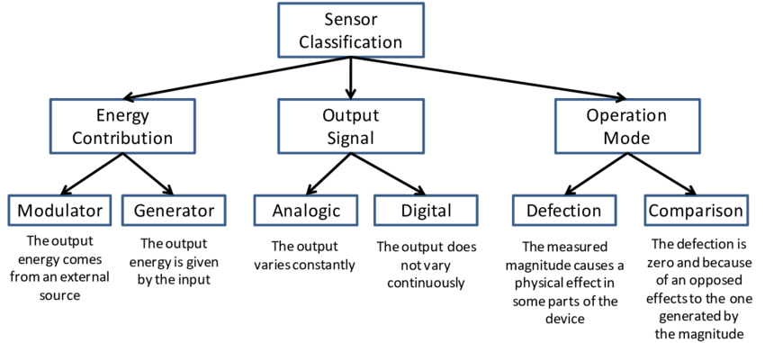
Sensor Classification

Slide 34
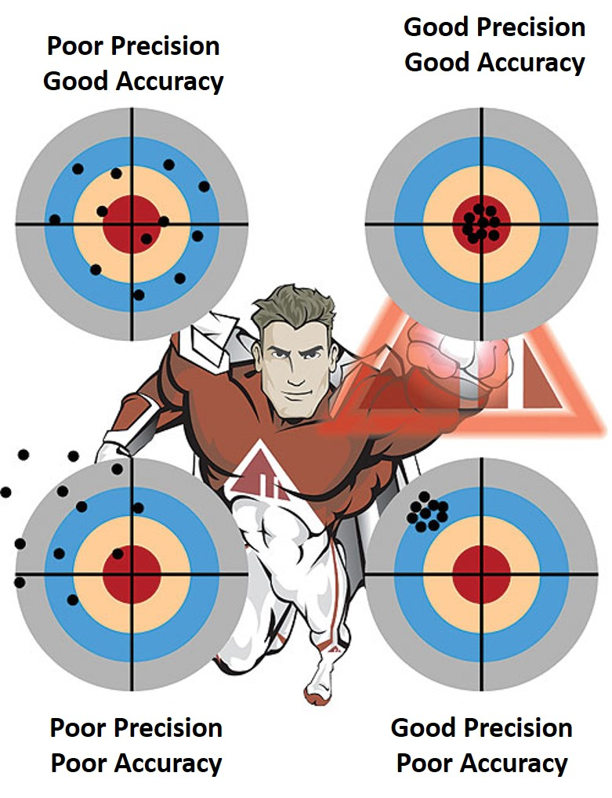
What are accuracy, error and repeatability in sensors?
Accuracy and precision are commonly confused terms.
ISO 5725 (1994) uses two terms “trueness” and “precision” to describe the accuracy of a measurement method.
Precision identifies the grouping or closeness of the readings.
trueness indicates the closeness of the test results to a reference or true value. This is more commonly referred to as accuracy.

Slide 35
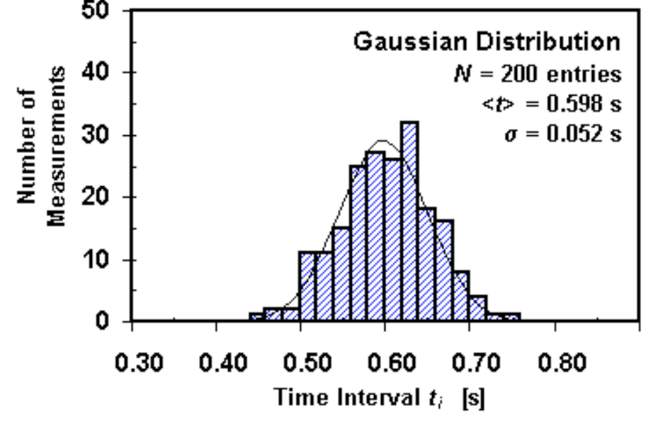
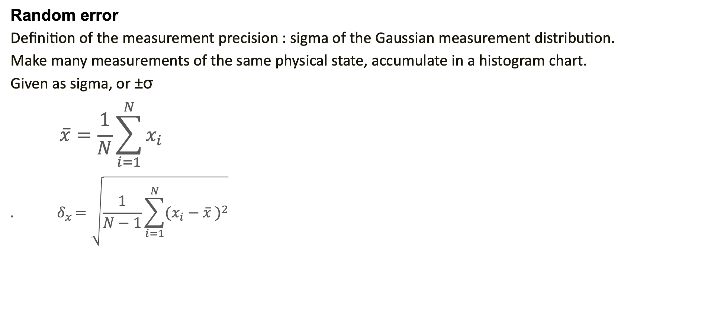
Sensors measurement basics
Random error
Definition of the measurement precision : sigma of the Gaussian measurement distribution.
Make many measurements of the same physical state, accumulate in a histogram chart.
Given as sigma, or ±σ
$$\overline{x}=\frac{1}{N}\sum_{i=1}^{N}{x_{i}}$$
$${. δ}_{x}=\sqrt{\frac{1}{N−1}\sum_{i=1}^{N}{{(x_{i}−\overline{x} )}^{2}}}$$

Slide 36
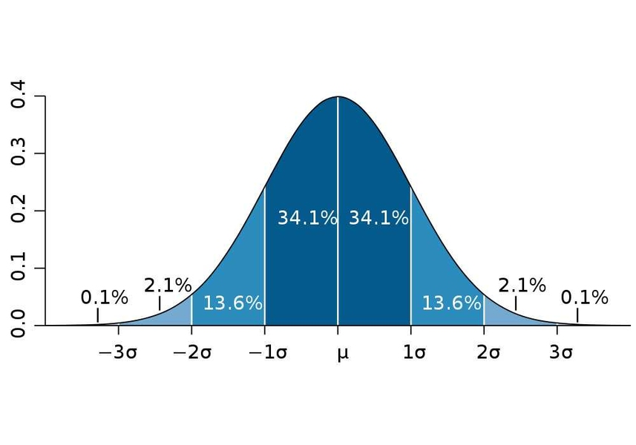
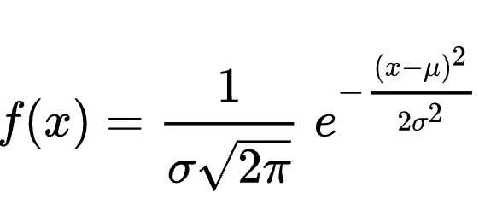
Gaussian distribution, multiple sigma intervals

Slide 37
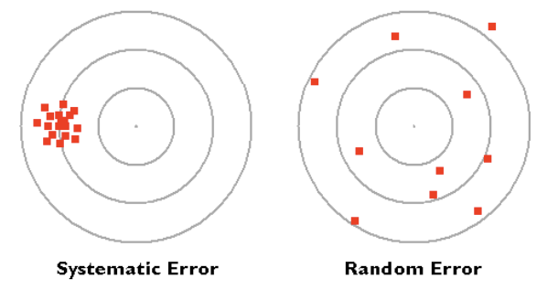
Sensors measurement basics
Measurement error improvement
Random error
à make multiple measurements (precision is reduced by 1/sqrt(n)).
à can be completely reduced to 0 (if you have enough time for the
measurement)
Systematic error
à find the source, incorporate into the mathematical model (calibrate) à source might be difficult to find and to quantify (humidity impact, temporal
drifts, ...) à are more annoying than random errors, frequent recalibration

Slide 38
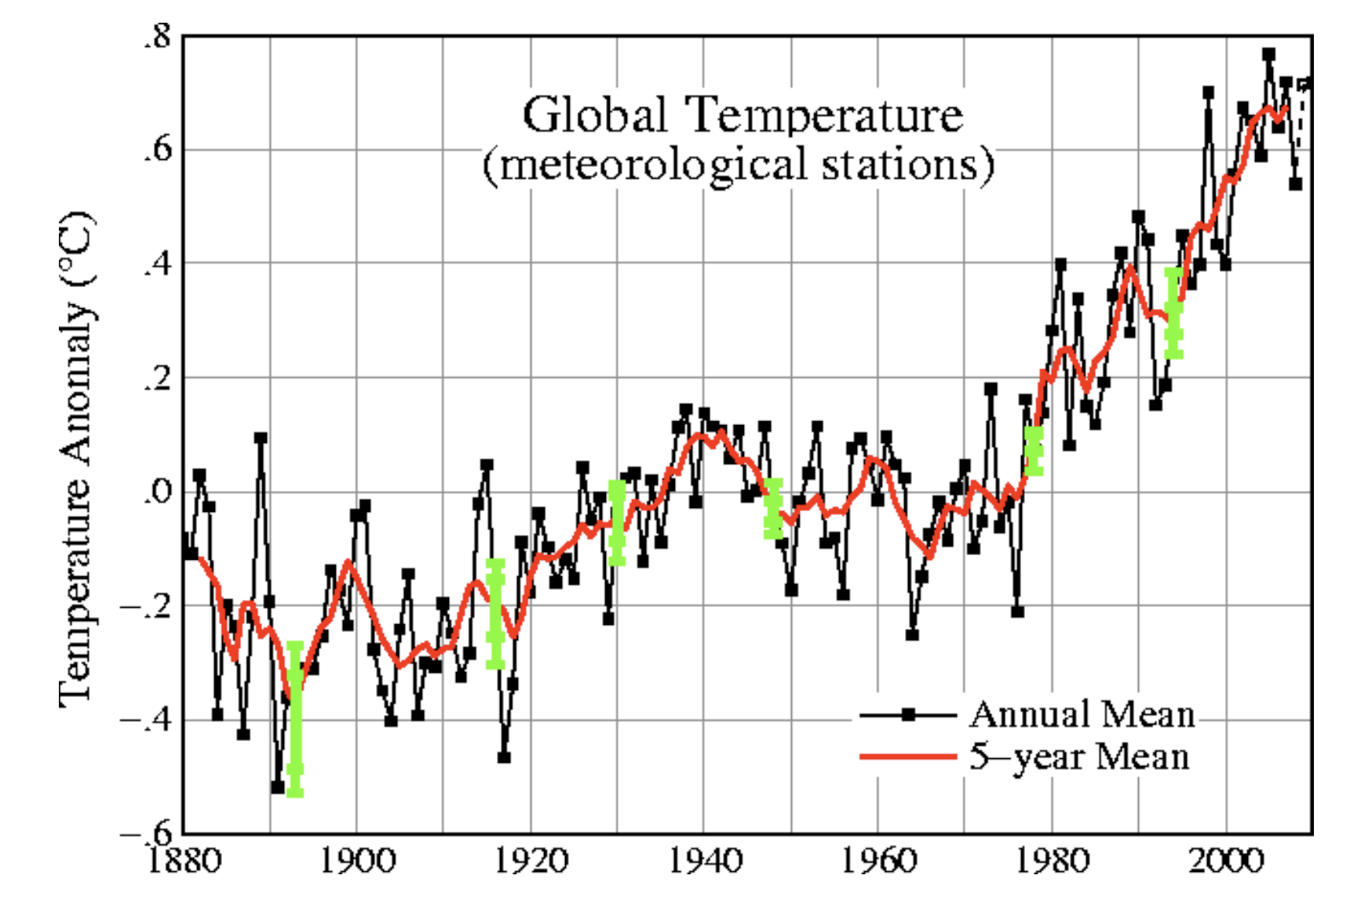
Sensors – Mesurement basics
Reducing random errors by extending temporal measurement interval

Slide 39
Resolution
Smallest increment in signal value.
If smaller than measurement precision, this gives the wrong impression of a “better” sensor than it is.

Slide 40
Sensors measurement basics
Response time
Time it takes to get a new signal value.
Dead time
After a measurement, some sensors are materially blocked for a certain time before a new measurement can be taken.

Slide 41
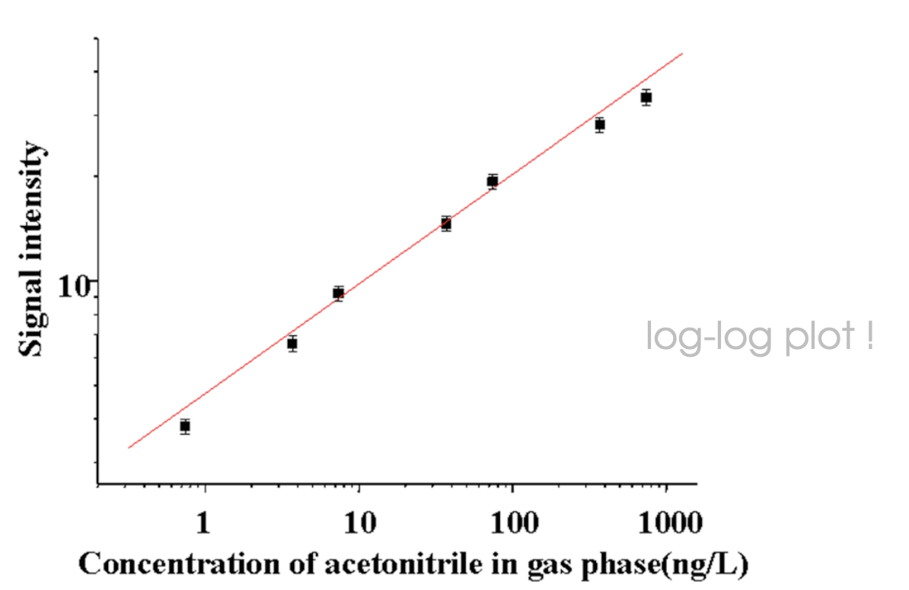
The transfer function
Make measurements at different levels of the physical quantity

Slide 42
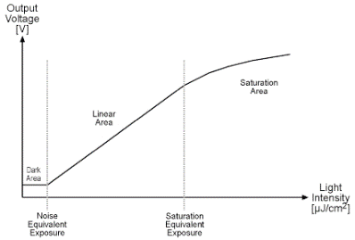
Sensors – measurement basics
Saturation

Slide 43
Range
The measurement range is the valid measurement interval of the physical quantity (within the proposed accuracy).
The range is given
> As minimum and maximum of the interval
> In dB with dB=10*log10(max/min)

Slide 44
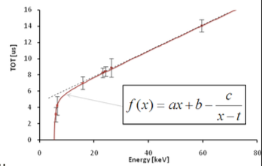
Calibration: find a mathematical model as transfer function & quantify its predictability strength
1. Find best mathematical model in order to obtain the physical quantity as function of the signal.
2. Estimate its performance
Physical quantity = func(value) Mathematical model of the transfer function can be linear, exponential, square,...
Comparing the transfer function and the model, you can estimate the measurements Range / accuracy / precision

Slide 45
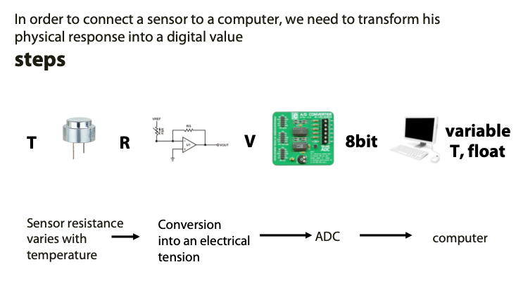
SENSORS signal processing scheme

Slide 46

Visible light communication system (LiFi) and indoor geolocation application
Front-End
Baseband
Baseband
Front-End
Path-loss
P_{TX}
P_{RX}
TX
RX
SNR = P_{RX}/P_{N}
VLC System Block Diagram

Slide 47
Q&A
Website: Perso.isep.fr/xzhang
Email: xun.zhang@isep.fr

